Slide 1


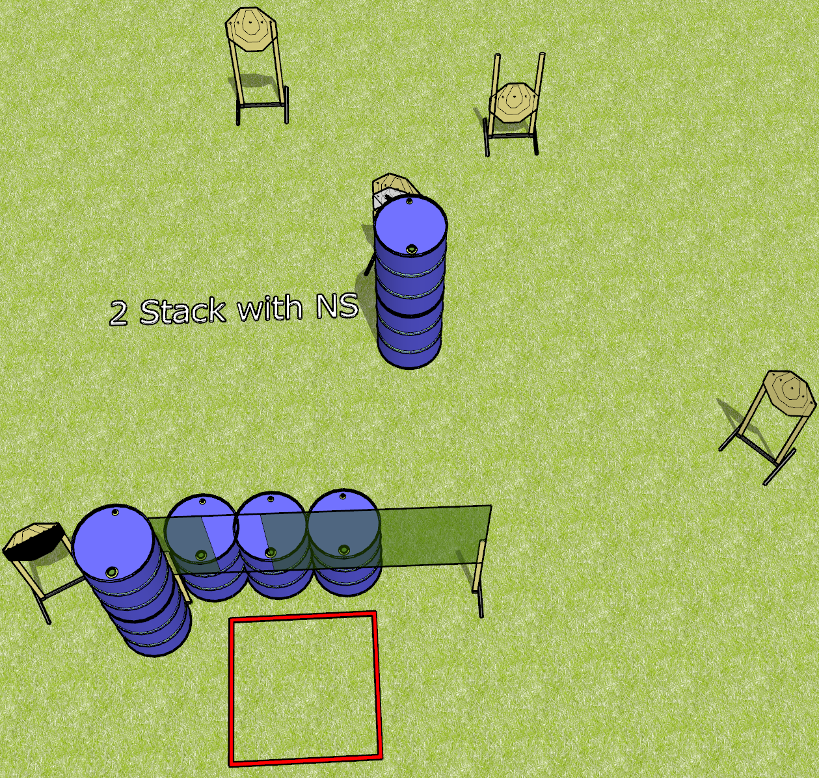
 | Dothan Gun Club – USPSA Match Ugly Course Designer : Drew Coleman
Round Count 18 rounds 6 IPSC
Equipment List 2 wall feet 1 4’ shooting box 1 50%

Slide 2
Ugly
Written Stage Briefing
Ugly is an 18 round, 90 point, Comstock course of fire. There are 6 IPSC targets. The best 3 hits will score.
Handgun start position is anywhere inside the shooting area, wrists below belt. Handgun is loaded and holstered.
PCC start position is anywhere inside the shooting area, stock on belt. Loaded carbine is held with both hands.
On the audible start signal, engage targets from within the shooting area. You may shoot under the wall.

Slide 3
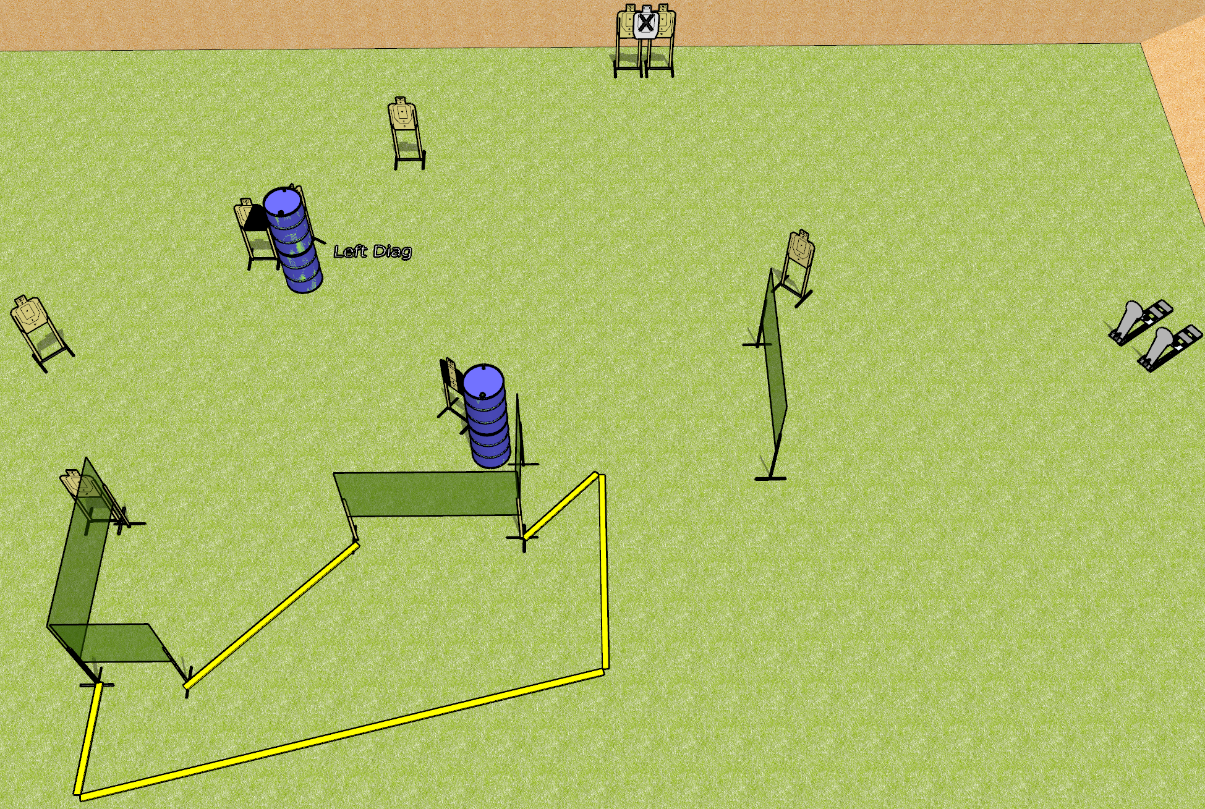
 | Dothan Gun Club – USPSA Match Checkmate Course Designer : Drew Coleman
Round Count 20 rounds 9 USPSA 2 colt poppers
Equipment List 8 wall feet 2 medium fault lines 1 left + 1 right diag, 1 tux 7 targets (6 + 1 NS)

Slide 4
Checkmate
Written Stage Briefing
Checkmate is a 20 round, 100 point, Comstock course of fire. There are 9 USPSA targets and 2 steel. The best 2 hits on cardboard will score and steel must fall to score.
Handgun start position is anywhere inside the shooting area, wrists below belt. Handgun is loaded and holstered.
PCC start position is anywhere inside the shooting area, stock on belt. Loaded carbine is held with both hands, safety on.
On the audible start signal, engage targets as they become available from within the shooting area. The last 3 targets engaged must be engaged strong hand only

Slide 5
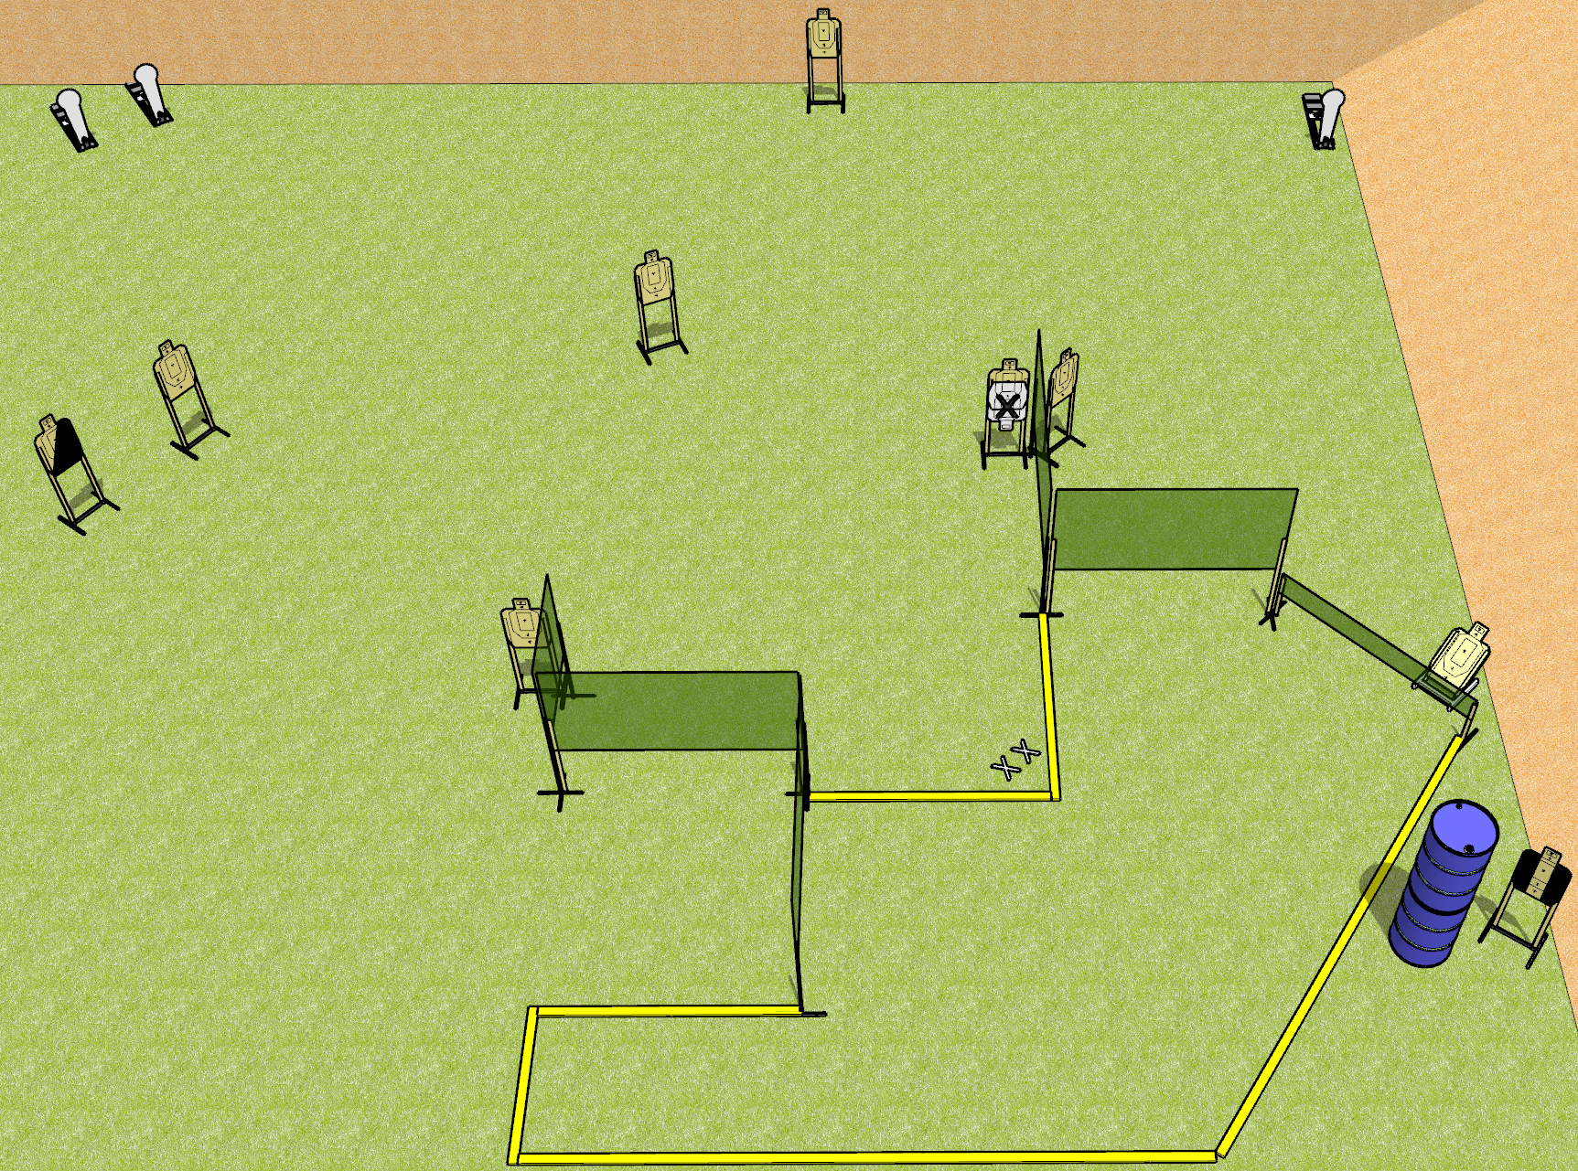
 | Dothan Gun Club – USPSA Match Empty Tank Course Designer : Drew Coleman
Round Count 21 rounds 9 USPSA 3 colt poppers
Equipment List 9 wall feet 1 left dia, 1 tux 8 targets (7 + 1 NS)

Slide 6
Empty Tank
Written Stage Briefing
Empty Tank is a 21 round, 110 point, Comstock course of fire. There are 9 USPSA targets and 3 steel. The best 2 hits on cardboard will score, and steel must fall to score.
Handgun start position is feet on X’s, wrists above respective shoulders. Handgun is UNLOADED and holstered.
PCC start position is feet on X’s, stock on belt. UNLOADED carbine is held with both hands.
On the audible start signal, engage targets as they become available from within the shooting area.

Slide 7
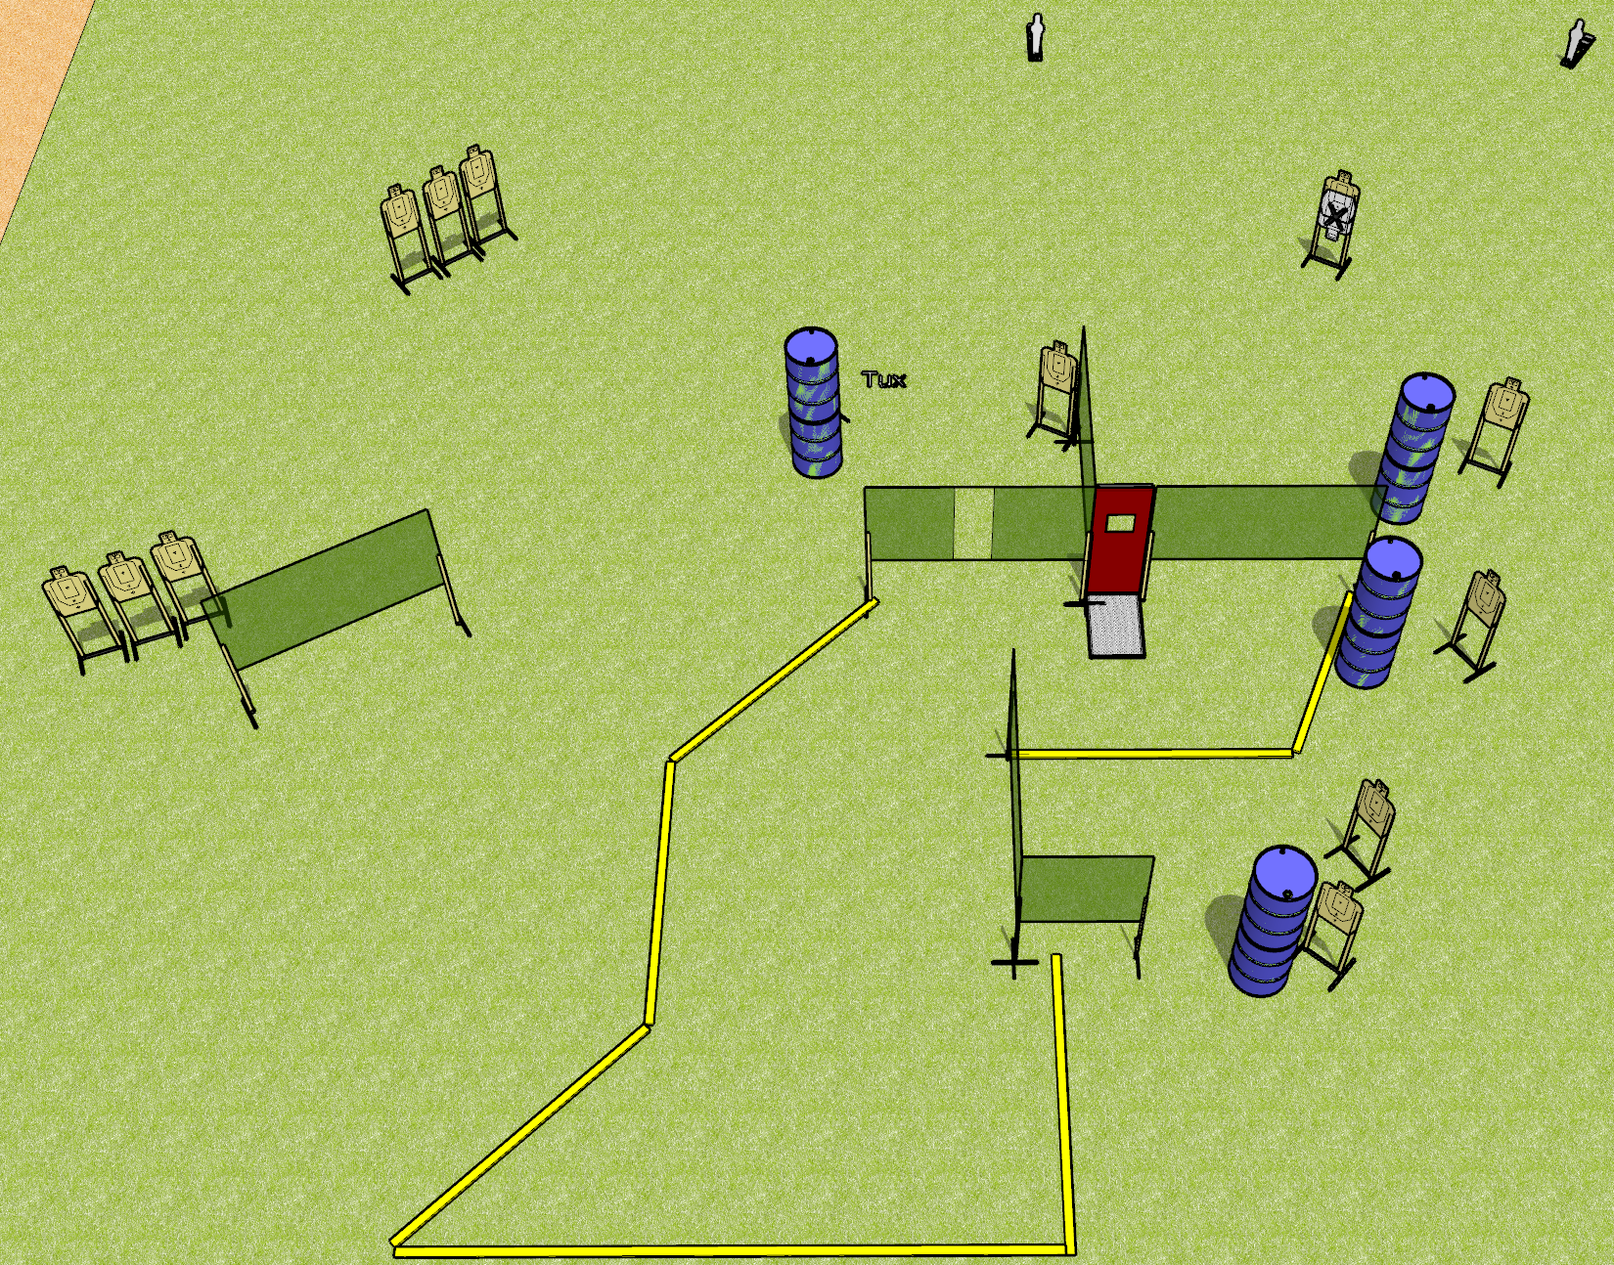
 | Dothan Gun Club – USPSA Match Not This Again Course Designer : Drew Coleman
Round Count 28 rounds 13 USPSA 2 mini poppers
Equipment List 10 wall feet 1 tux 13 targets (12 + 1 NS)

Slide 8
Not This Again
Written Stage Briefing
Not This Again is a 28 round, 140 point, Comstock course of fire. There are 13 USPSA targets and 2 steel. The best 2 hits on cardboard will score and steel must fall to score. The start signal is audible.
Handgun start position is anywhere inside the shooting area, wrists below belt. Handgun is loaded and holstered.
PCC start position is anywhere inside the shooting area, stock on belt. Loaded carbine is held with both hands.
On the audible start signal, engage targets as they become available from within the shooting area.

Slide 9
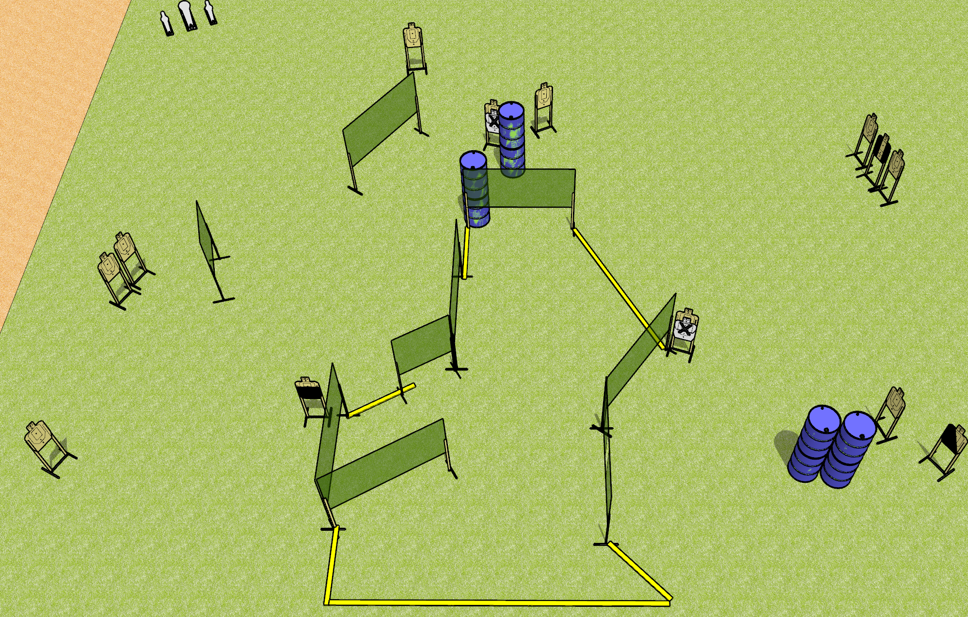
 | Dothan Gun Club – USPSA Match Get Back Course Designer : Drew Coleman
Round Count 29 rounds 13 USPSA 1 colt, 2 minis
Equipment List 18 wall feet 4 medium fault lines 1 tux, 1 50%, 1 left diag 12 paper (2NS + 10 open)
XX

Slide 10
Get Back
Written Stage Briefing
Get Back is a 29 round, 145 point, Comstock course of fire. There are 13 USPSA targets and 3 steel. The best 2 hits on cardboard will score, and steel must fall to score.
Handgun start position is both hands touching marks. Handgun is loaded and holstered.
PCC start position is muzzle touching either mark, stock on belt. Loaded carbine is held with both hands, safety on.
On the audible start signal, engage targets as they become available from within the shooting area.

